Slide 1
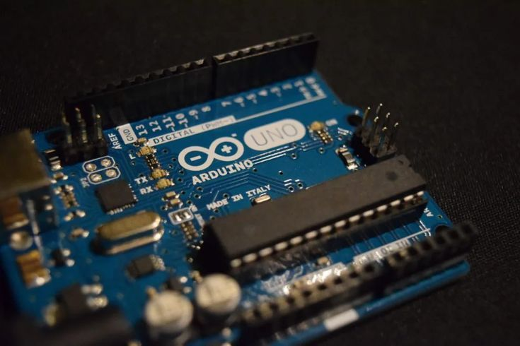
MICROPROCESSORS PROJECT
GROUP- 15
SMART AC ADJUSTER
YAMOAH, Darien Kwesi Kusi
YAWSON, Ernest Arkoh
NINNONI, Reuben Mwinzie
ARHIN, Fredrick
ARTHUR, Elvy Ekow
ARTHUR, Keziah Naana Aba
ARYEE, Papa Kofi Ankobiah
ARYEETEY, Rodney-Roy Ebenezer
ASAMOAH, Michel Boadi
ASAMOAH, Philip

Slide 2
GROUP MEMBERS
NAME | INDEX NUMBER
Keziah Naana Aba Arthur | 18464322
Aryeetey Rodney-Roy Ebenezer | 1846522
Papa Kofi Ankobiah Aryee | 1846422
Michel Boadi Asamoah | 1846622
Yamoah Darien | 1862622
Yawson Ernest Arkoh | 1862722
Elvy Ekow Arthur | 1846222
Asamoah Philip | 1846722
Fredrick Arhin | 1846122
SMART AC ADJUSTER

Slide 3
TABLE OF CONTENT
1. INTRODUCTION……………………………………
2. PROBLEM STATEMENT………………………….
3. SYSTEM DESIGN (SCHEMATICS)…………….
3.1. SYSTEM COMPONENTS……………..
3.2. METHODOLOGY…………………………
4. DEMONSTRATION (SIMULATION)………….
5. CONCLUSION………………………………………..
6. REFERENCES…………………………………………
SMART AC ADJUSTER

Slide 4
INTRODUCTION
Traditional air conditions run on fixed settings, leading to inefficiency, high energy consumption and less ideal comfort. They require manual adjustments for changing conditions. Our smart AC adjuster solves this problem by automatically optimizing temperature based on the environment and user preferences. Our system helps conserve energy, enhances comfort through adaptive learning, and allows remote monitoring using advanced sensors like the DHT22 sensor.
SMART AC ADJUSTER

Slide 5
PROBLEM STATEMENT
In many indoor environments, maintaining an optimal room temperature is vital for comfort and energy efficiency. Traditional air conditioners require manual adjustments, which can be inconvenient and inefficient, leading to high consumption or discomfort due to slow responses to temperature changes.
SMART AC ADJUSTER

Slide 6
METHODOLOGY:
SOLUTION TO PROBLEM
To address this issue, we designed a Smart AC Adjuster that automates the regulation of an air conditioner's temperature based on real-time room conditions, temperature and humidity. By integrating sensors and infrared (IR) communication, the system automatically adjusts the AC settings without user intervention, enhancing convenience and energy efficiency.
SMART AC ADJUSTER

Slide 7
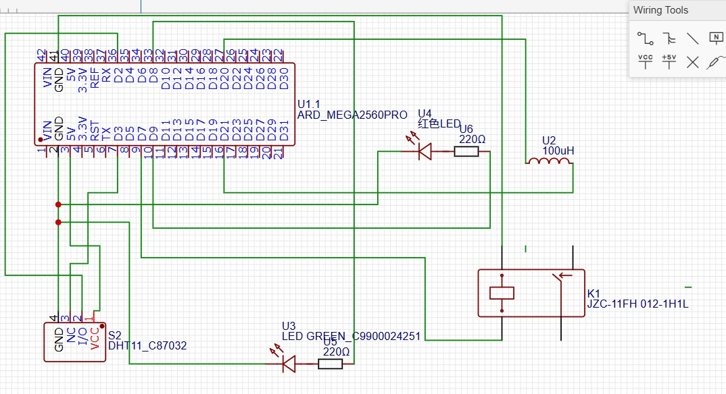
METHODOLOGY:
OVERVIEW OF SCHEMATIC
SMART AC ADJUSTER

Slide 8
METHODOLOGY:
OVERVIEW OF THE CODE
The code is written in C++, specifically the Arduino variant of C++. The code uses the following hardware components and libraries:
COMPONENT | PURPOSE
DHT11 | Reads temperature.
Arduino/ ESP32 | Microcontroller for processing.
IR Blaster | Sends IR signals to AC
DHT.h | Reads sensor data
IRremote.h | Receives IR signals
Adafruit_GFX.h | Provides graphical functions for the OLED
Adafruit_SSD1306.h | Controls the OLED display.
Wire.h | Handles I2C communication which is required for devices like OLED displays, sensors, and other I2C-based peripherals.
SMART AC ADJUSTER

Slide 9
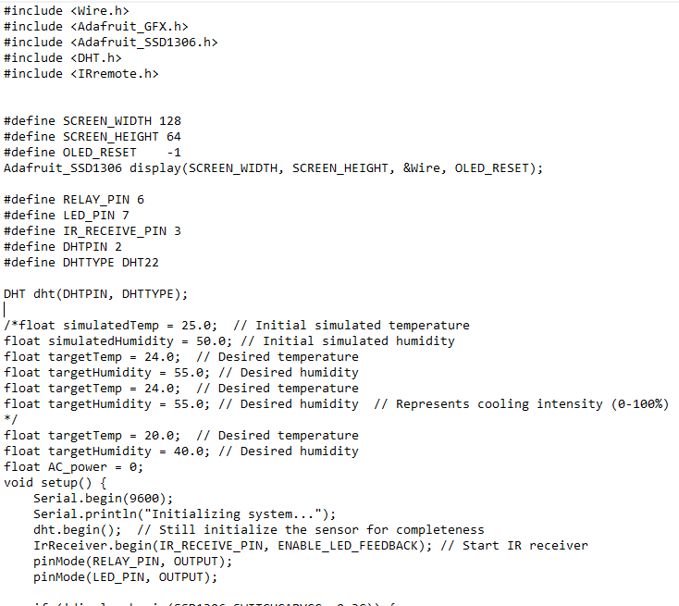
METHODOLOGY:
OVERVIEW OF THE CODE
SMART AC ADJUSTER

Slide 10
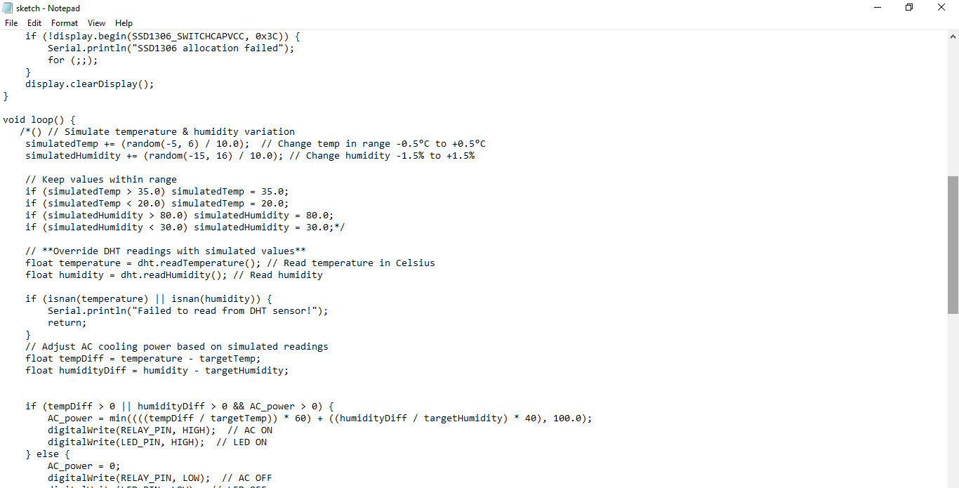
METHODOLOGY:
OVERVIEW OF THE CODE
SMART AC ADJUSTER

Slide 11
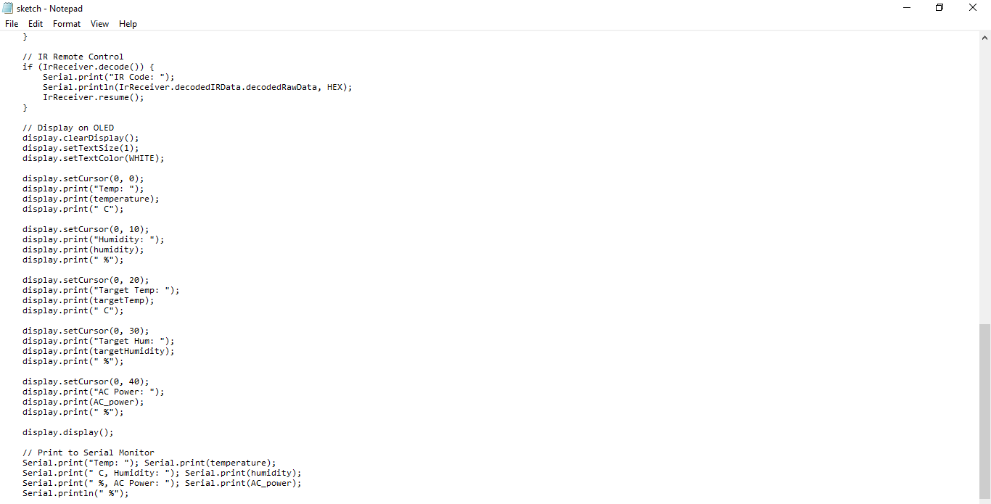
METHODOLOGY:
OVERVIEW OF THE CODE
SMART AC ADJUSTER

Slide 12
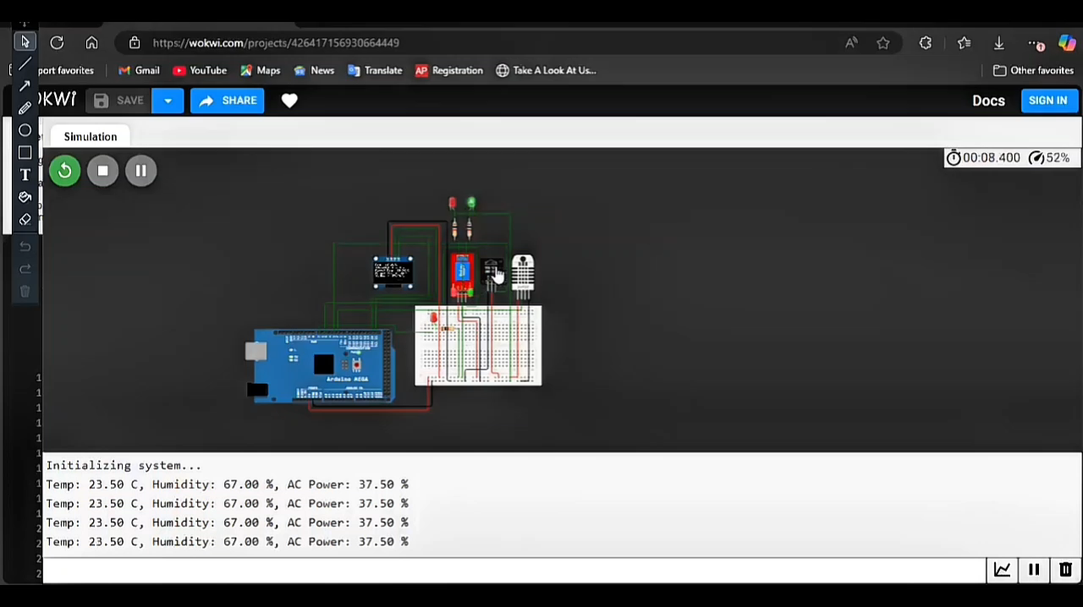
SIMULATION
The video shows the simulation of the AC Adjuster, responding to changes in humidity and temperature while conserving energy.
SMART AC ADJUSTER

Slide 13
DEMONSTRATION AND KEY TAKEAWAYS
REAL TIME TEMPERATURE READINGS:
The system continuously reads the temperature from the DHT22 Sensor.
It displays temperature readings on the MONITOR for debugging.
KEY TAKEAWAYS:
Temperature is updated every 5 seconds.
The system automatically turns the AC ON/OFF based on the set threshold.
2. AC CONTROL OUTPUT (IR SIGNAL):
An infrared signal is sent to control the AC.
KEY TAKEAWAYS:
The IR LED blinks when sending an IR signal.
The AC unit responds immediately to the control signal.
SMART AC ADJUSTER

Slide 14
DEMONSTRATION AND KEY TAKEAWAYS
EFFECTIVENESS OF THE SYSTEM:
The system succesfully maintains a stable room temperature by automatically.
It reduces energy consumption by turning the AC OFF when not needed.
The simulation conducted using Wokwi confirmed the correctness of the system’s software logic.
SMART AC ADJUSTER

Slide 15
CONCLUSION
FINDINGS:
The smart AC Controller successfully automates AC adjustments based on real-time temperature readings.
The system reduces energy consumption by turning OFF AC when cooling the room is not needed.
CHALLENGES ENCOUNTED:
We had problems depending on WI-FI because, there were delays and lags in remote controlling the AC.
The IR Signal system varied across different AC brands.
The DHT11 sensor performed slightly ineffective as compred to the DHT22 sensor.
SMART AC ADJUSTER

Slide 16
CONCLUSION
POSSIBLE IMPROVEMENTS:
Intelligent Learning with Machine Learning: Implementing machine learning algorithms that analyze user preferences and automatically adjust AC settings.
Achieving greater accuracy by integrating more precise environmental simulations. These enhanced models will provide realistic variations in temperature and humidity.
Integrating PIR motion sensors to detect room occupancy. This ensures that the AC operates only when necessary, turning on when someone is present and shutting off when the room is vacant.
Smart Error Detection & Alerts: The system will continuously monitor power consumption and operational behavior to identify potential faults.
Implement Manual Override for User Control: Providing users with greater flexibility, we will include a manual override function.
Manual Override for User Control: Providing users with greater flexibility, we will include a manual override function.
SMART AC ADJUSTER

Slide 17
REFERENCES
IMPEMENTATION OF A SMART AC AUTOMATION SYSTEM WITH ROOM TEMPERATURE PREDICTION BY: F.M. JAVED MEHEDI SHAMRAT, SHAIKA MUHAMMAD ALLAYEAR AND MD. ISMAIL JABIULLAH: https://www.academia.edu/42077056/Implementation_of_a_Smart_AC_Automation_System_with_Room_Temperature_Prediction
Ssrn-5060859.pdf BY BAKU, ABSHERON: https://papers.ssrn.com/sol3/papers.cfm?abstract_id=5060859
ENABLING SMART AIR CONDITIONING BY SENSOR DEVELOPMENT BY: CHIN-CHI CHENG and DASHENG LEE: https://www.researchgate.net/publication/311241163_Enabling_Smart_Air_Condition_by_Sensor_Development_A_Review
IR TRANSMISSION REQUIRES SPECIFIC AC REMOTES CODES: https://cielowigle.com/
OLED DISPLAY FOR USABILITY: https://create.Arduino.cc/projecthub
SMART AC ADJUSTER

Slide 18
REFERENCES
FINE-TUNING BY SIMULATING SENSOR DATA REQUIRE:
https://www.designnews.com/
OPTIMIZED AC USAGE: https://www.ijeetc.com/upload file/2021/0319/20210319031711178.pdf
ENERGY SAVINGS AND PERFORMANCE: https://www.sciencedirect.com/science/article/pii/S2666123323000612
SMART AC ADJUSTER

